Slide 1
Using Task Modules with bots

Slide 2

Overview
Invoking task modules from bots
Processing task module submissions in bots
Developing bots with task modules

Slide 3
Task Modules & Bots
Notes:
In this section, we will explore working with task modules in the context of a bot

Slide 4
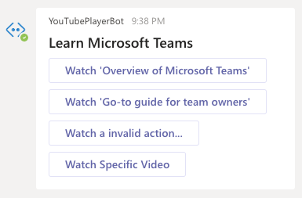
Task Modules & bots
Bots can invoke and process submissions from task modules
Bots differ from tabs and deep links:
There is no user-interface for a user to act on to trigger the opening of a task module
Bots run in a service external to Microsoft Teams
Microsoft’s Bot Framework & the Microsoft Teams SDK have added support for
Invoking task modules
Handling the Action.Submit event where a task module submits information back to the bot
Notes:
So far in this module, you've learned how to create task modules as HTML web pages and Adaptive Cards. You've learned how to use these task modules from tabs as well as invoking them using Microsoft Teams' support for deep links.
Another way you can use task modules is from bots. Bots present a unique challenge in that there's no user interface to interact with a bot, rather all communication is typically done using conversations.
Microsoft's Bot Framework and the Microsoft Teams SDKs have added support for not only invoking task modules, but also to handle the **Action.Submit** event in the case where task modules submit information back to the bot.

Slide 5
Invoke & Process Task Modules from bots
Notes:
In this section, we will explore how to invoke task modules with deep links

Slide 6
Invoking Task Modules from bots
Bots can invoke task modules in one of two ways:
Create a deep link and embed it in a message the user can select
Reply/send a special type of message to the Bot Framework & Microsoft Teams
Message details:
type = invoke
value.type = task/fetch or task/submit
Notes:
Recall from a previous unit, the process of invoking a task module is to call the `submitTask(taskInfo, submitHandler)` method in the Microsoft Teams JavaScript SDK. This method won't work when invoking the task module from the bot because the bot's code is running as a web service external to Microsoft Teams.
Instead, you have two options for invoking a task module from a bot.
One option is to use a deep link that is included in the message posted to the **Conversations** tab in Microsoft Teams by the bot. When a user selects this link, it will invoke the task module.
The other option is to send a special type of message to the Bot Framework and therefore, to Microsoft Teams. This message can be sent from a card action or from the bot itself.

Slide 7
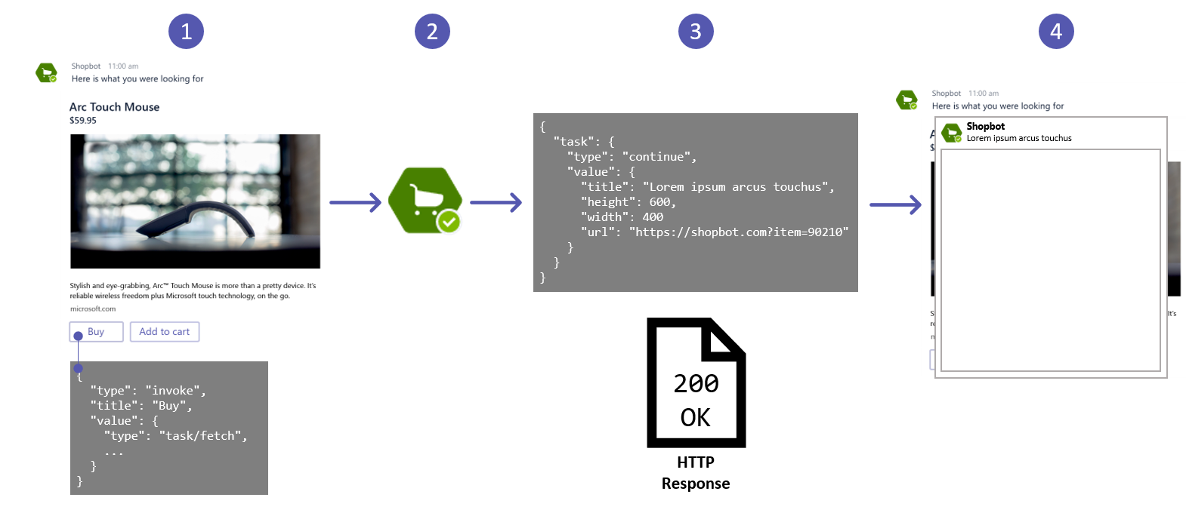
Task Module Invocation from a Bot - How it Works
Notes:
Let's look at how this works
To create the message, set a button's type to `invoke`. The `value.type` property of the button should be set to `task/fetch`, or `Action.Submit` for cards.
When the user selects the button, it will send an HTTP POST `invoke` message to the bot. The Microsoft Teams SDK automatically processes all `invoke` messages and directs them to one of two handlers.
These handlers return an object of type `TaskModuleRepose` that tells Microsoft Teams to either display a message or to display another task module.
The details of the response, either a message or task module, are included in the `value` property of the returned object.

Slide 8
Handing invoke message types in a bot
Microsoft Teams’ SDK captures and forwards messages to one of two handlers developers can override on the bot class
Messages of type task/fetch processed by handleTeamsTaskModuleFetch()
Called when prompted to display a task module
Messages of type task/submit processed by handleTeamsTaskModuleSubmit()
Called when a task module submits back to it’s caller/host
Similar to submitHandler(error: string, result: object|any) callback in the SDK
Notes:
To create the message, set a button's type to `invoke`. The `value.type` property of the button should be set to `task/fetch`, or `Action.Submit` for cards.
When the user selects the button, it will send an HTTP POST `invoke` message to the bot. The Microsoft Teams SDK automatically processes all `invoke` messages and directs them to one of two handlers:
`handleTeamsTaskModuleFetch()`: called when the `value.type` property of the message is `task/fetch`
`handleTeamsTaskModuleSubmit()`: called when the `value.type` property of the message is `task/submit`

Slide 9
Invoke message callbacks responses
Both invoke message handlers return an object of type TaskModuleResponse
Indicates to either display a message or another task module:
Message:
{ "task": { "type": "message", "value": "Message text } }
Task module:
{ "task": {
"type": "continue",
"value": { "title": <TaskModuleTaskInfo object> }
}
}
Notes:
Both of these methods return an object of type `TaskModuleResponse`. This object tells Microsoft Teams to either display a message (`type: "message"`) or to display another task module (`type: "continue"`).
The details of the response, either a message or a task module, are included in the `value` property of the returned object.
For example, the following response from either of the two handlers to display a message.

Slide 10
Demo

Slide 11
Thank you.

